Slide 1

PATH TO AI
Technology is the sum of techniques, skills, methods, and processes used in the production of goods or services or in the accomplishment of objectives, such as scientific investigation. Technology can be the knowledge of techniques, processes, and the like, or it can be embedded in machines to allow for operation without detailed knowledge of their workings. Systems applying technology by taking an input, changing it according to the system's use, and then producing an outcome are referred to as technology systems or technological systems.
Notes:
QuickStarter has created an outline to help you get started on your presentation. Some slides include information here in the notes to provide additional topics for you to research.

Slide 2

AI

Slide 3
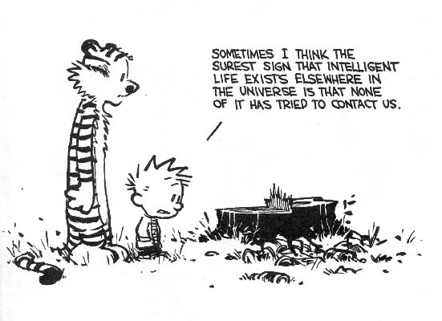
What is Intelligence?
Intelligence:
“the capacity to learn and solve problems” (Webster's dictionary)
in particular,
the ability to solve novel problems
the ability to act rationally
the ability to act like humans
Varying kinds and degrees of intelligence occur in people, animals and now machines.

Slide 4
What is Artificial Intelligence?
Artificial Intelligence (AI) is the attempt for computers to perform intelligent actions.
According to John McCarthy, AI is the science and the engineering of making intelligent machines, especially intelligent computer programs.
Artificial intelligence (AI) is the simulation of human intelligence processes by machines, especially computer systems. These processes include learning (the acquisition of information and rules for using the information), reasoning (using rules to reach approximate or definite conclusions) and self-correction.

Slide 5
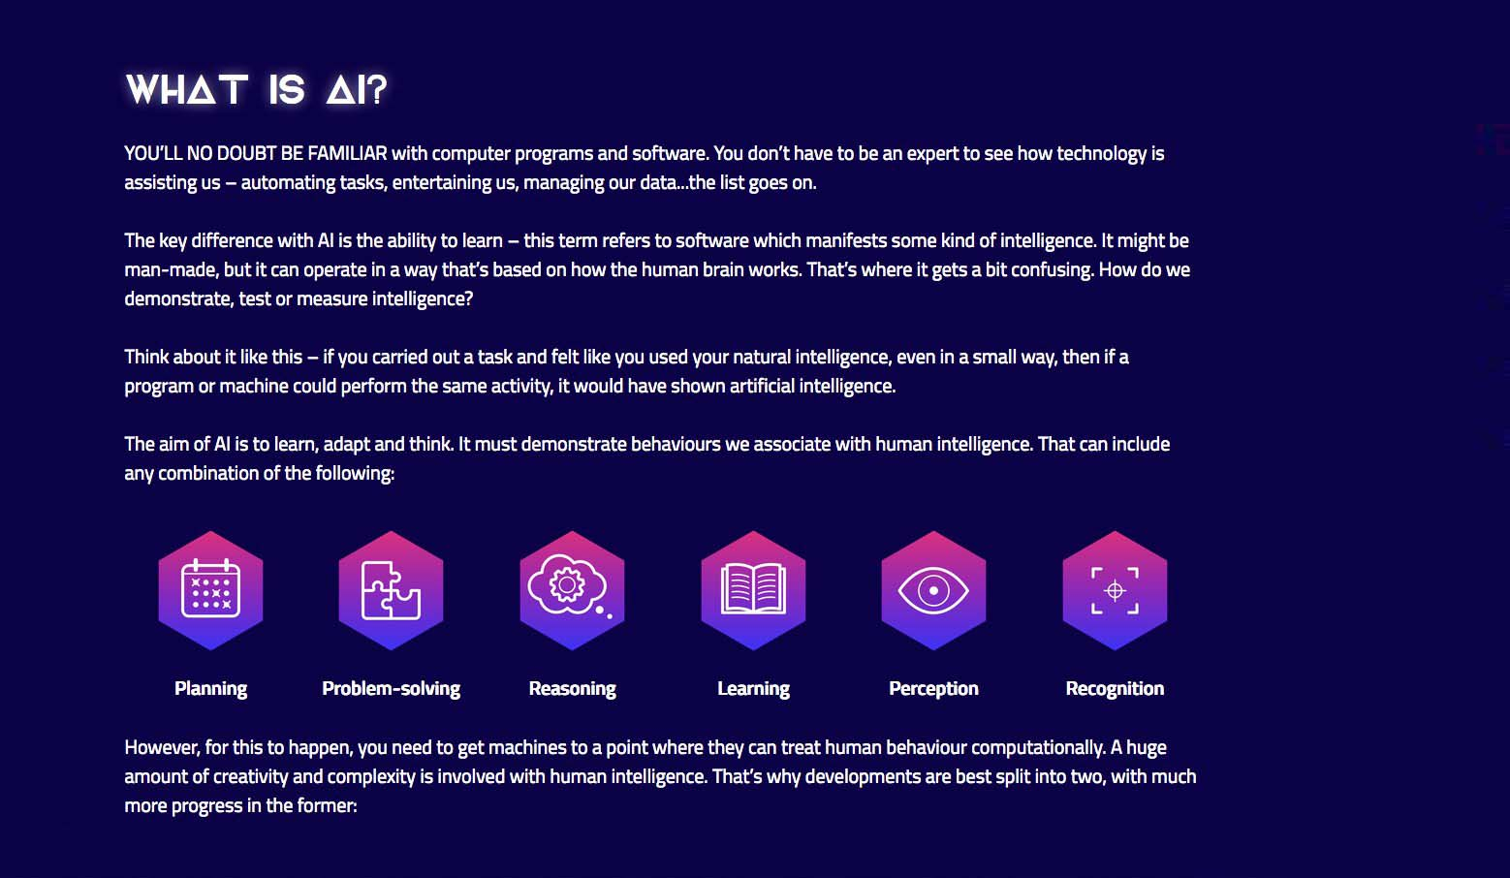
What is AI?

Slide 6
AI is a system which will typically demonstrate at least some of the following behaviors associated with human intelligence:
planning, learning, reasoning, problem solving, knowledge representation, perception, motion, and manipulation and, to a lesser extent, social intelligence and creativity.
AI can be simply divided into two streams: Generalised AI, which we call as Machine Learning (ML) and Applied AI, which focuses on replicating human behavior, such as making robots. “Artificial intelligence (or AI) is a system of computing that aims to mimic the power of the human brain. We have more than 100 trillion neurons, or electrically conducting cells in our brain, that give us the incredible computing power for which we are known. Computers can do things like multiply 134,341 by 989,999 really well, but they can’t do things like recognize human faces or learn or change their understanding of the world. At least not yet, and that’s the goal of AI: to devise a computer system that can learn, process images and otherwise be human-like

Slide 7
AI Introduction Video
https://www.youtube.com/watch?v=l95h4alXfAA

Slide 8
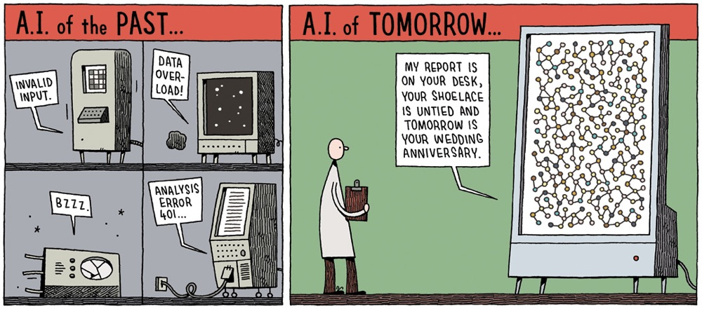

Slide 9
What is AI and not AI
Conventional Computing | Artificial Intelligence
Programmer tells the system exactly how to solve the problem | Programmer specifies the problem to the system and not the exact steps to solve the problem
Can solve only a specific problem in a given domain | Can solve a range of problems in a given domain
Need all the input data | Complete input data not needed
Solution is deterministic | Solution can be probabilistic

Slide 10
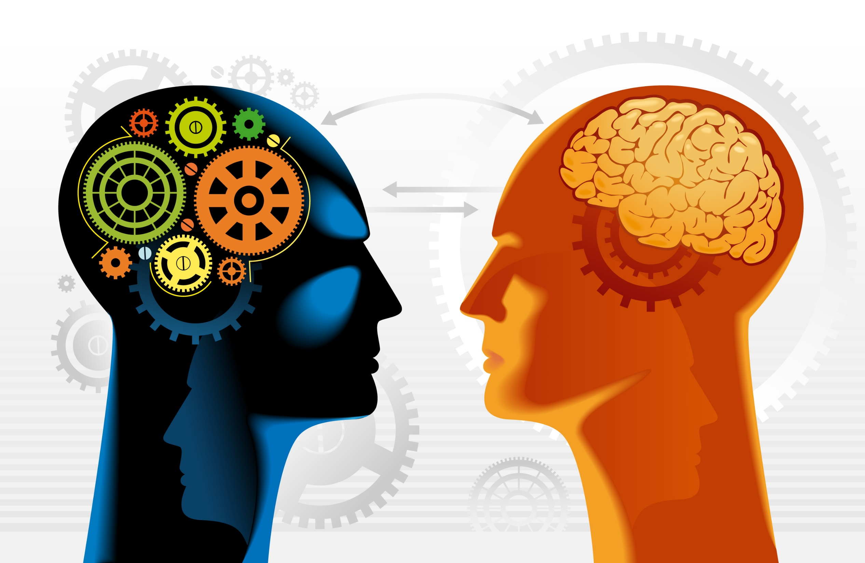
AI within you

Slide 11

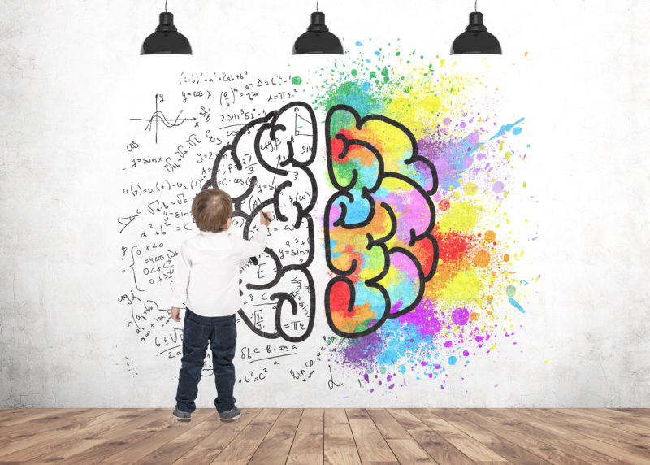
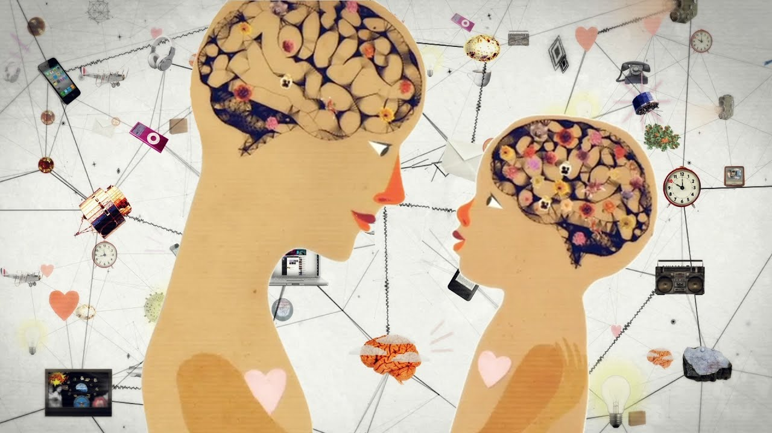
Brain is most advance AI which exist in this world till date:

Slide 12
Notes:
Quotes by Technology:
"I was the principal negotiator for the Department of Defense, when I was secretary of the Navy, on the issue of Toshiba technology concerns with American submarines."
"Television has changed the American child from an irresistable force to an immovable object."
"Everyone has a right to a university degree in America, even if it's in Hamburger Technology."
"The music and movie business has been consistently wrong in its claims that new platforms and channels would be the end of its businesses. In each case, the new technology produced a new market far larger than the impact it had on the existing market."
"The federal government... knows how to put a missile in someone's room half way around the world with technology. Why don't we use some of that technology to save some lives here in America?"
"If your strategy calls for you to be in America, then you will go into America. If your strategy calls for you to be in M&A, then you'll do an acquisition. You usually acquire a company to acquire technology, geographic advantage, etc. Similarly, geographic expansion is very much like M&A. It's done to advance a strategy."
"Making duplicate copies and computer printouts of things no one wanted even one of in the first place is giving America a new sense of purpose."
"I think we should be very worried because, with technology, Boko Haram and other terrorists have become very mobile in all continents, not only in Africa but also in Europe, America, and Asia."
"Once archaeologists have shown possible 'new' ancient features, they can import the data into their iPads and take it to the field to do survey or excavation work. Technology doesn't mean we aren't digging in the dirt anymore - it's just that we know better where to dig."
"In the technology world, you have to execute fast or you're out of business."

Slide 13

Works cited

